Slide 1
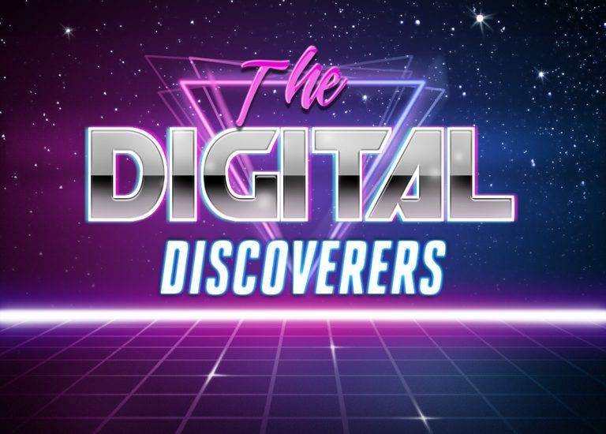
[insert full page splash photo of the people, the tech, whatever]

Slide 2
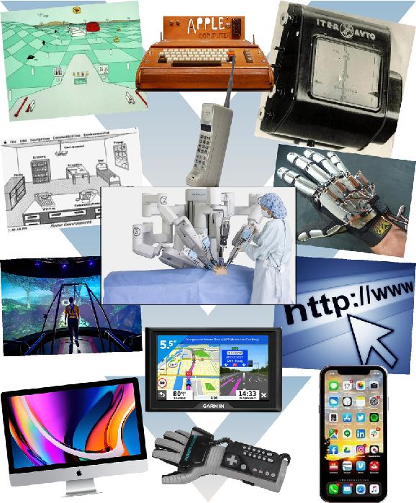
Series Overview - www.TheDigitalDiscoverers.com
Do you know who actually invented the internet? No, it wasn’t Al Gore. It was the man whose name coined the term "Cerfing the web".
How about the person who created the world's first voice recognition, voice synthesizing, home automation, virtual reality O.S., ToolTips, and the on-screen thumb, keyboard which underlies every major piece of computer technology at our fingertips?
OK, here’s an easy one, who invented the cell phone? Steve Jobs? Wrong again! How about the people who created the first Personal Computer, MP3 player, Virtual Reality, and GPS? Give up?
What if I told you that nearly all technology that humans interact with every day can be traced back to a handful of men and women, who all were pieces of a worldwide complex technological puzzle that lead to all the technology we see around us today?
Smartphones, gaming, computers, virtual reality, NASA space travel, telepresent medical surgery, smart cars, the internet, voice recognition, voice synthesizing, on screen thumb keyboards, home automation, all-in-one media controllers, helping the disabled and saving lives Do you know anyone’s name?
This small group of pioneers and innovators are responsible for trillions of dollars worth of global economy, including being directly responsible for 2 of the world’s largest companies, and indirectly responsible for thousands more, paving the way for every major innovation over the last 30 years. They were all working on their own independent projects gaining their own mass and momentum until like gravity, fate pull them all together.
FORMAT: 8eps x 60min

Slide 3
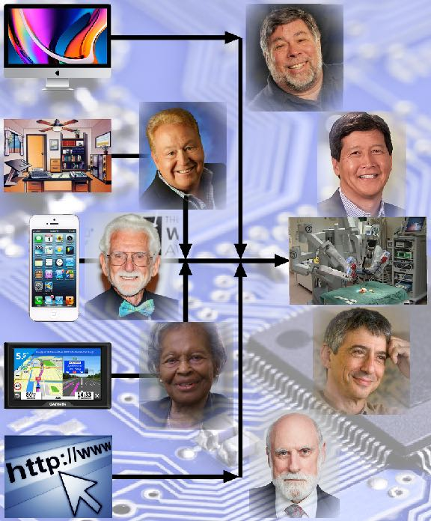
Feature Overview
The Digital Discoverers explores the exciting and unknown history behind the technology that is responsible for everything around us and how we live today, told firsthand from the innovators, entrepreneurs, and pioneers who created the world we live in.
Sometimes heartbreaking, hilarious, with shocking twists, inspiring moments, nostalgic memories, antiquated technology (remember floppy disks?), and even cutting edge technology. This series will dive into the crazy unknown stories from our digital founders about how they did it and where this technology is taking us into the future!
Interviews will be choreographed between The Discoverers, people who knew and worked with them (for better or worse!) and carefully selected interviews from audience driving, current generation pioneers, and celebrities who owe their careers to The Discoverer’s innovations.
FORMAT: 8eps x 60min

Slide 4
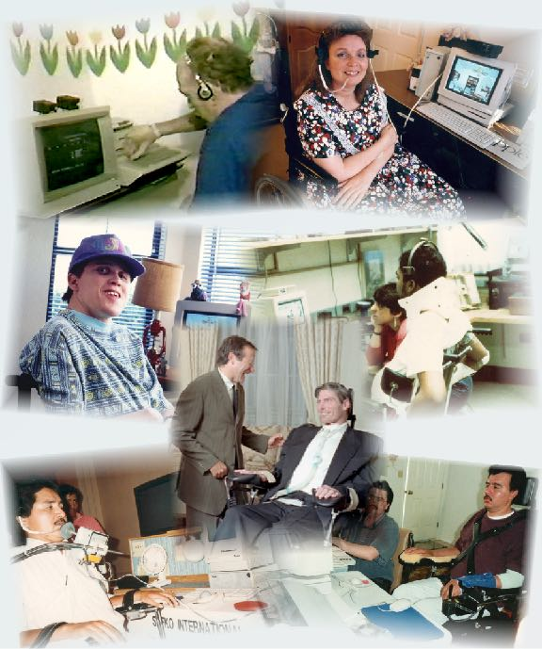
Series Episode 1: Lon Safko
The typical American innovator asking the question “What if?” while he tinkers away in his garage workshop alone at night. Typical? Don’t bet on it! That question and others lead to the creation of the $15.3 billion Assistive Technology Industry, and a journey that no one would believe!
A two decade struggle fighting the biggest companies in America from stealing his I.P. suing Apple, Microsoft, Motorola, and Sony. Fighting off several Racketeer Influenced and Corrupt Organizations (RICO) suits, seeing one CEO removed by the sheriff. Seeing his I.P. show up in the next Apple OS and they simply responding with ‘Yeah, we took it because it was so good!” Raising millions of dollars in multiple private placements, dozens of Wall Street presentations, shareholder’s lawsuits, Penny Stock and other SEC fraud, hostile take overs, and watching his company’s value go from millions of dollars to 100’s of thousands of dollars in debt - DELIBERATELY!
And though it all, the Innovation stayed the course. Through thick and thin, he continued to save the lives of the disabled and working with “Superman” (Christopher Reeve) with his quadriplegia, Arthur C. Clarke’s post-polio syndrome, and 100’s of disabled from around the world. Never tiring, never giving up, watching his company growing from only him in a lonely garage to nearly 50 employees, 25 national sales offices, and three international offices being driven to him, back in the garage by himself.
See how another small news segment in a small town, made it to the (Bird) satellite and was seen by John Scully, CEO of Apple who called Lon personally and summoned him to Cupertino to work alongside of Apple and help build “Isle 15”, the first corporate recognition of the 50m disabled in America.
Coined “The First Computer to Save a Human Life” when Steve Jobs returned to Apple and saw the computer on display at Apple’s HQ and said “If that’s what this is… Then put a F@#$ing sign on it that says that!”

Slide 5
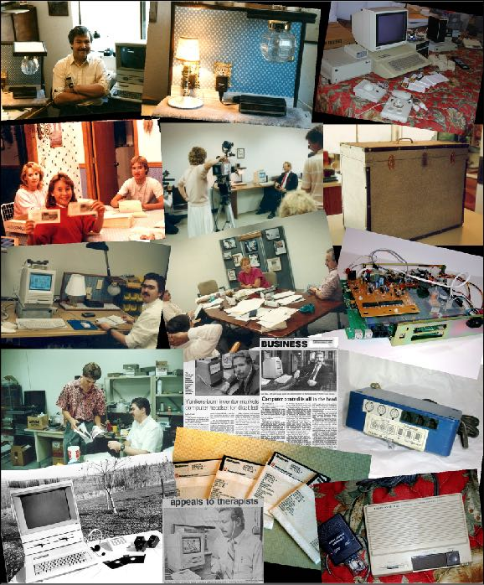
Series Episode 1: Lon Safko
Continued
“My company was struggling and I was about to lose everything. I was working out of a little office space, just Keith and myself. Every time we would sell a system, we’d build the next system, pay some bills, and if there was anything left, Keith would get it. We never got ahead. My wife Sherrie worked her a** off the whole time keeping our family afloat. We ran completely out of money when I met a group of four prestigious investors who were interested in investing in my business and helping the disabled. It seemed too good to be true and I agreed, hoping that the influx of cash would help me save the business.
The investors immediately brought on dozens of shareholders, pushed me to the side, and began to deliberately run my company into the ground. I wasn’t sure why with all their experience they would deliberately destroy my company. Suddenly it became clear, their strategy was to stage a hostile takeover and bankrupt the company! Once bankrupt, they had cut a deal with the judge to buy the entire company for a mere $100k and own all the IP themselves. I fought back with everything I had, but the company collapsed.
Working from a spare bedroom, I informed them that if they had read their due diligence they would have seen a subtle clause in their contract stating that the company owned NONE of the IP, and that I personally owned it all, and licensed it to the company for $1 a year. They missed their $1 payment and all of the IP reverted back to me! The investors (all multi-millionaires) went insane, threatening me to give them all the IP and “If I personally benefit from helping the disabled in anyway, they will use their combined resources to be sure that my wife and I lived in a trailer park the rest of your lives.”
Up against all odds, facing down business juggernauts set on my destruction, I played the only card I had left, a kamikaze move. I released 100% of my IP into the public domain!” They got nothing and the world benefited from decades of my work. There are 18 inventions in the Smithsonian Institution and more than 30,000 of my documents.

Slide 6
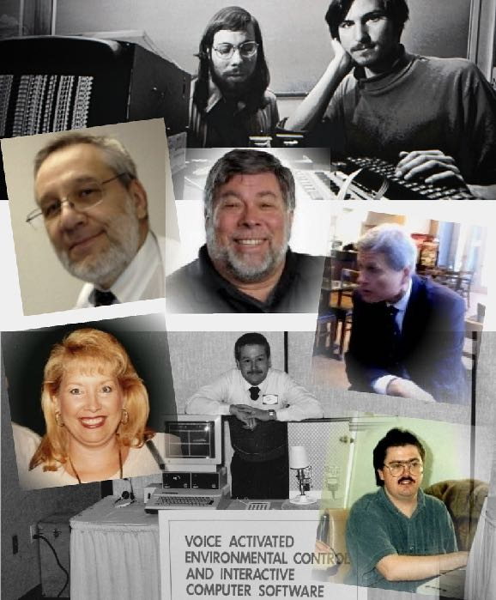
Series Associate Interviews
Sherrie Safko, Lon’s wife, told him on a first date that him putting the computer in a box and not helping the disabled was the “most selfish thing I have ever heard.” She continuously pushed Lon to further his development, and supported him through the trials and tribulations that saved lives around the world and built the $15.3 Industry.
Keith Fisher, Worked for free for Lon, the “brightest student” the local college had ever seen. Within a few years, he became the Vice President of Engineering and went on to develop dozens of electronic devices to help the disabled. He now develops artificial intelligence for companies like Intuit and Taco Bell.
Dr. Sam Wise, Helped trial Lon’s SenSei system, while director of the Disability Division of the Palo Alto Veterans Administration Hospital. Sam invented the DataGlove while working under a grant from NASA / DARPA, which is currently used today by astronauts to repair satellites from within the ISS, and by Mattel for kids to play their Nintendo. Sam will be the subject of his own episode.
Larry Scarborough, Managing Partner, Bryan Cave Attorneys at Law, who represented Apple against Microsoft in the 189 copyright infringement case Macintosh vs Windows. He also assisted Lon in his lawsuit and cease and desist against Microsoft and the “Bob” operating system which Bill Gates Sr., stole from Lon. Lon Killed Bob!
Steve Wozniak, Co-Founder of Apple Computer and founder of Cloud9, a Los Gatos startup and inventor of the first Infrared, All-In-One Media Controller worked with Lon to allow his device to help the disabled. The Woz will will be the subject of his own episode.

Slide 7
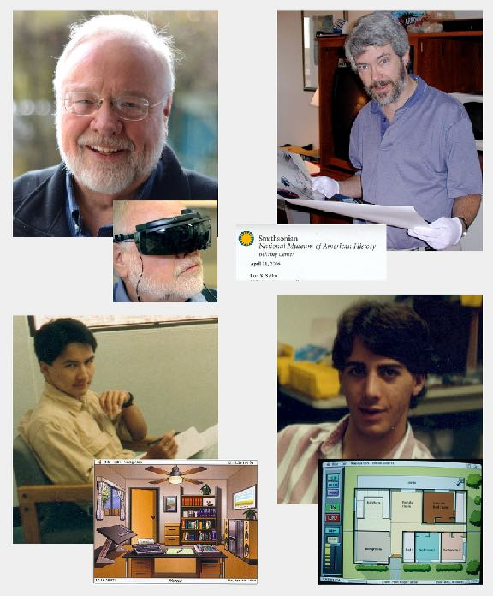
Series Associate Interviews
Continued
Ray Powers, Software Programmer, and early employee fresh out of trade school became one of the company’s first and best programmers.
Aki Hirota, Graphic Designer, who designed all the last generation screens, buttons, and human interfaces. Lon sponsored him and his wife for an American Work Visa which allowed them to become American Citizens. Aki went on to a successful career in industrial graphics design.
Rick Warden, Special Education Therapist, worked with Skip a 15 year old quadrepelegic who, at 12 was crushed by a garbage truck. Rick taught Skip how to use the SenSei System to graduate high school and invite the girl of his dreams to the prom.
Craig Orr, Senior Archivist for The Smithsonian Institution in Washington, D.C., came to Lon on the other side of the country to chose 18 inventions and more than 30,000 of Lon’s professional papers for the Smithsonian. Craig was sent by the Director of the Smithsonian who said “Lon has made more of a contribution to the human / computer interface as has anyone.” Craig is now is the Sr. Curator for the Smithsonian Institution.
Dr. Thomas Furness, the inventor of Virtual Reality, invited Lon to the University of Washington to meet Bill Gates Sr. to help him raise money for his ever struggling company. Tom was asked to verify Lon’s work. Tom’s response? “I spent 16 years, working with more than a dozen Ph.D.s, and spent 100’s of millions of dollars creating a multi-million dollar computer system for V.R.. Lon did it for $2,500!” Tom will be the subject of his own episode.

Slide 8
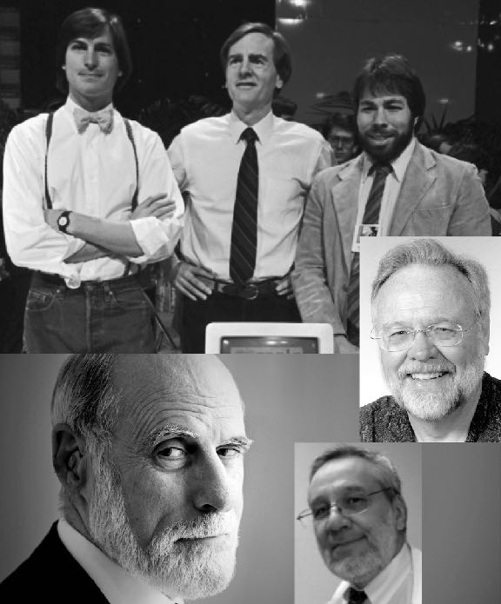
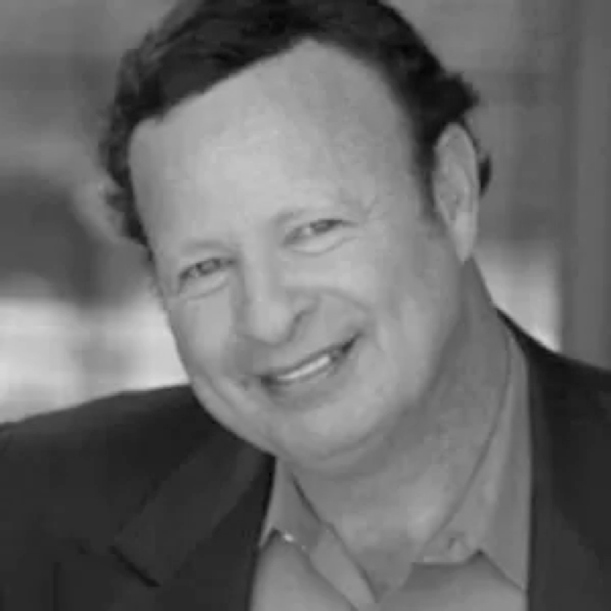
Additional Episodes 2-5
Episode 2: Steve Wozniak, Co-Founder of Apple Computer, Inc.
The Woz’s technology impacted today’s world in ways we are still experiencing. It wasn’t always Million dollar stock options and fame. The two Steve’s started from humble beginnings in a garage in Los Altos, California. No company, no money, no help, and no idea how they were going to put their own personal “Dents In The Universe!” Interviews T.B.D.
Episode 3: Vint Cerf: “Father of the Internet”
Just an engineer working for DARPA along with a dozen others, Vint changed the world! He had a simple vision, how can we connect a dozen military bases and universities together and keep the connection in the event of a nuclear attack. The man responsible for “http://www”, Vint Cerf gave new meaning to the term “Cerfing” the web! Interviews T.B.D.
Episode 4: Dr. Nathan Schulhof, Inventor of the “MP3 Player”
Technology entrepreneur Nathan Schulhof invented the first MP3 player – Audio Highway’s ‘Listen Up’ in the mid-90s, unearthing a brand-new way to consume music, and thereby changing the industry forever. His idea was subsequently copied by his competitor, Philips, who tried to push him out of business to make way for their own device. Apple released the superior ‘iPod’ soon after, and the rest is history.
Episode 5: Dr. Thomas Furness, “The Father of Virtual Reality
Dr. Furness was challenged with creating a system that would allow an F-15 Fighter Pilot to take off, perform their maneuvers, and land while their cockpit was painted black. They had to fly using a virtual simulation of the reality below the pilot. More than a dozen years, a dozen Ph.D.s, and 100’s of millions of dollars, Dr. Furness invented the V.R., Virtual Reality we see today. Interviews T.B.D.

Slide 9
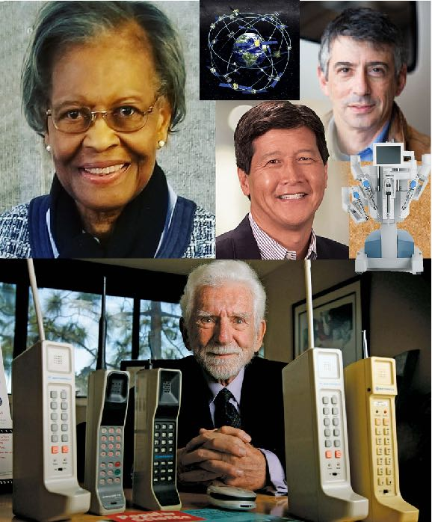
ADDITIONAL Episodes 6-8
Continued
Episode 6: Gladys West, Inventor of GPS
Gladys is an American hero and mathematician known for her contributions to the mathematical modeling of the shape of the Earth, Einstein's Theory of Relativity Time Warping, and her work on the development of the satellite geodesy models that were eventually incorporated into the Global Positioning System (GPS). Gladys is 90 years old. Interviews T.B.D.
Episode 7: Martin Cooper, “Father of the Cell Phone”
Growing up from immigrant parents, and later serving during the Korean War, Marty built himself into a “wireless visionary who reshaped the concept of mobile communication”. After decades of work and fierce competition with AT&T, Martin was responsible for creating two-way radio dispatch, quartz crystal manufacture, pagers, and the world’s first cell phone. His first cell phone call was not to his wife, but to his competitor; AT&T.
Interviews: Satya Nadella (CEO Microsoft), Vint Cerf (“Father of the Internet”), George Fisher (CEO Motorola), plus additional Interviews T.B.D.
Episode 8: Jonathan Sackier & Yulun Wang, Co-Inventors of the Da Vinci Machine
Jonathan & Yulan are considered the fathers of modern surgical robotics, with the first FDA approved surgical robot and used in the world’s first telesurgery procedure, known as the Lindbergh Operation. The Da Vinci Machine brings it all together! They are credited with helping to develop medical technologies including laparoscopic surgery, amniotic stem cells and the first commercial surgical robot, AESOP, and now the immensely successful Da Vinci robotic surgery system which has saved over 6,000 lives to date. Interviews T.B.D.

Slide 10
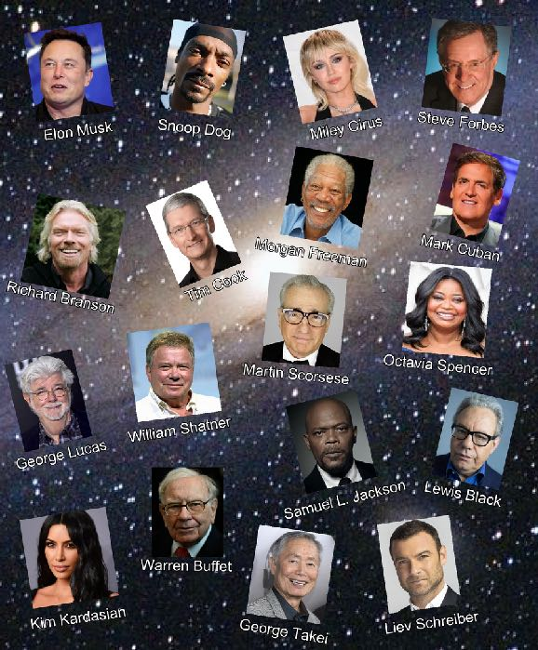
Series Overview Interviews
This is a suggested list of Overview Interviews with celebrities, influencers, moguls, and innovators, which will give different perspectives, entertaining cameo interviews, and bring huge amounts of viewers to this series.
The list is comprised of people such as:
Steve Forbes | Elon Musk | Mark Cuban | Tim Cook
Richard Branson | William Shatner | George Takei | George Lucas
Kim Kardashian | Snoop Dog | Miley Cirus | Liev Schreiber
Lewis Black | Morgan Freeman | Warren Buffet | Martin Scorsese
Samuel L. Jackson | Octavia Spencer | Biz Stone | Marissa Mayer
An “Internal” list of interviews include people who have compelling and interesting perspectives, such as workers who ate cantaloupe in their cars because they couldn’t get paid, people who got screwed, people who succeeded, and people that were close to the company that have a different viewpoints on what actually happened and how this project affected their lives. Some made money, some went broke, and even some died trying.
Each of the Episode Characters will have an extensive list of their own personal contacts, interviews, friends, mega-celebrities, and famous people to add to this list.

Slide 11
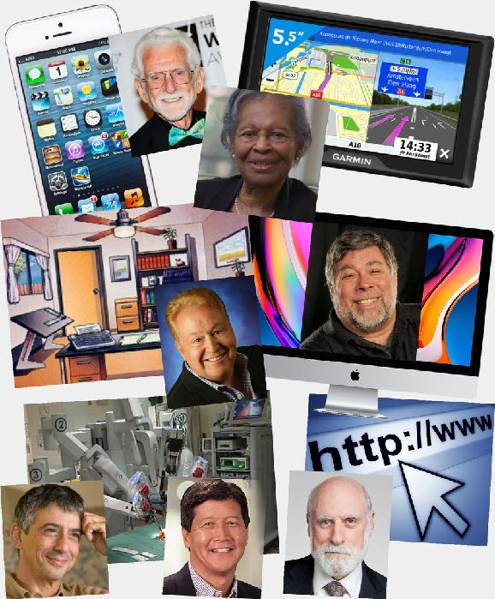
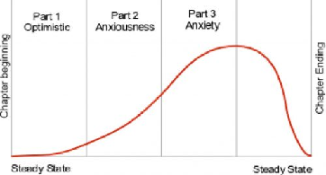
Suggested Episode Structure
I have authored 21 books; 15 business books, 3 historic fiction westerns, 1 SciFi, and 1 historic, and 1 self-discovery, 6 of which hit #1 on Amazon and I have been nominated for a Pulitzer Prize.
What I learned particularly from the fiction books is that the telling of a story requires a cadence, a rhythm. As an example, in the historic fiction westerns, Each chapter is set up as self contained mini-adventures composed of three parts; 1) the hero’s enthusiasm, optimism, and intentions for that chapter, 2) the antagonist and his intentions, 3) the confrontation between the hero and the antagonist where the hero generally loses but is proven safe in the last sentence. This structure repeats itself chapter after chapter until the last chapter where the hero wins all.
By creating this structure, I subconsciously manipulate the reader through three stages of psychological emotions. In Part 1, they are presented with happy optimism, they feel good about the plot and themselves. In part 2, I move them to apprehension, anxiousness, and a low level of fear. In Part 3, I create the conflict and anxiety, pump the adrenaline, and allow the reader (Viewer) to personally relate to the hero’s struggle. Then the last sentence relinquishes the feelings of dread and returns the reader to a steady state of calm and peace.
Too little anxiety / adrenaline and you lose the reader’s attention, while too much anxiety / adrenaline and you over-stimulate and burn out the reader. It is the balance or cadence of calm, anxiety, calm, that keeps the reader / viewer engaged.
A copy of my book “Love, Lust, Death”, #2 in the series of historic fiction westerns will be provided upon request.

Slide 12
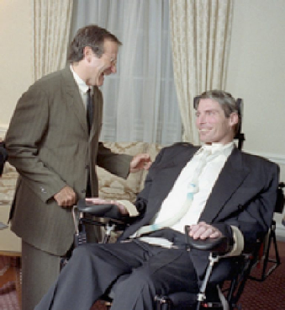
Suggested Episode Structure
This content will attract Baby-Boomers and Gen X-Y as they grew up alongside of this technology as it evolved with them. Now, Millennials, the second largest demographic, are consuming digital streaming media at an alarming rate and in different ways than other demographics. Most content Millennials consume is in constant stream of small bite sized pieces. A series of studies have shown that as technology has become increasingly prevalent and immediate, the human attention span has been steadily declining.
“Researchers found a decrease in human attention span across all age groups and genders. The average attention span has now dropped to eight seconds, with the goldfish standing in at nine seconds.”
https://www.iflscience.com/brain/do-you-have-lower-attention-span-goldfish/
This means that the editing of this series is critical whereby all visuals need to change between 3 and 5 seconds, favoring the 3 second length. We have seen that in other successful productions.
Duration
Each of these chapters could run for approximately 11 minutes, for a total of 5 chapters. This gives us 2:30 for introductions and 2:30 to conclude for an overall total of 60 minutes.
These rules can be applied to The Digital Discoverers. Specifically…
Part 1
Part 1, is the idea, the inspiration, the American entrepreneurial spirit. E.g.: It came to me like a flash, I knew I was onto something, so I went into my garage and started to tinker around, I created a working prototype, I knew I could change the world and would never give up trying. The reason more inventions happen in the U.S than any other country on earth is… We have more garages per capita than any other country!
Part 2
Part 2, I needed funding, if I quit my job I could work on this full time but if I do, I can’t feed my family, pay my mortgage, I need to take this from a prototype in a garage into a real live company. I need a business plan and raise venture capital, but how?
Part 3
Part 3, then the vultures flew in, trying every possible way to steal my idea, force me out of business, and compete with me to destroy me and my dream. Hostile take-overs, RICO lawsuits, Copyright infringements, Fortune 500 companies stealing my ideas!
Last part of the chapter, the return to the Steady State; e.g.: But I knew I could not give up when I saw the 50 year old quadriplegic man sip on a straw, moved his head around and signed his name, and begin to cry. The nurse told me that was the first time he could sign his name since the accident. He had been given back his identity.

Slide 13
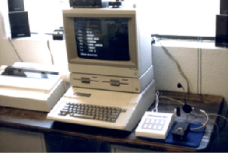
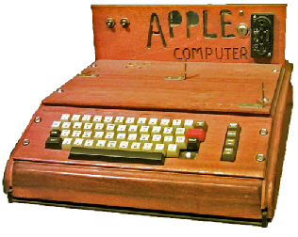
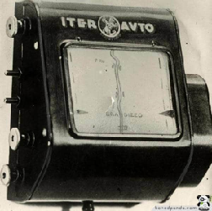
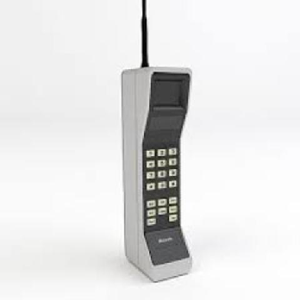
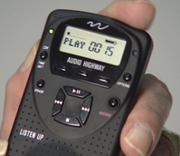
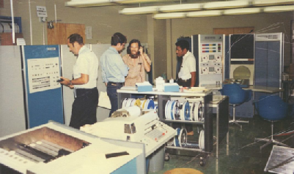
The First Episode (Pilot)
“The First Computer To Save A Human Life”
As it will be much easier to draw out my stories than others, we will start with my story, “The First Computer To Save A Human Life” as the Pilot Episode.
The Digital Discoverers… The men and women who invented, created, and developed the technology take for granted, all have in our pockets, and can’t live without.
These are people who had a vision and were willing to sacrifice themselves and their families to realize their dreams of making the world a better place and putting their dent in the universe.
These are the people who suffered and worked tirelessly day and night with no money, no friends, and often no food to breathe life into their dreams and nurture their visions from conception to success.
In this series, we will tell their stories and share with you the journey of inspiration from the garage to the boardroom, maybe inspiring you to become the next Steve Jobs, Mark Zuckerberg, or Bill Gates.
The Digital Discoverers were people just like you and me who had a vision and was willing to do whatever it took to make it succeed.
Now sit back and be amazed.
Scene Change…
Here’s a quick quiz… Let’s see how many you can guess. Ready?
• Who invented the first computer to save a human life?
• Who invented the first P.C., Personal Computer?
• Who invented GPS?
• Who invented the first MP3 Player? Not Steve Jobs.
• Who invented the first Cell Phone? Again, not Steve Jobs.
• Who invented the Internet? And no, it wasn’t Al Gore.

Slide 14

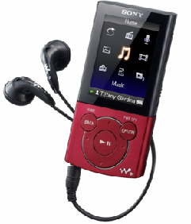
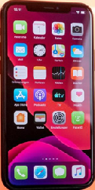
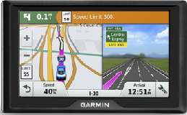

The First Episode (Pilot)
How many did you get? What to try again?
• Who was the first to commercialize voice synthesizing (a talking computer)?
• Who was the first to utilize voice recognition (a listening computer)?
• Who was the first to commercialize home automation (to turn lights on and off)?
• Who was the first to create Tool Tips (the little window that pops open to tell you what a button does?
• Who invented the first on screen keyboard?
• Who was the first to build a chatbot, virtual reality operating system, and artificial intelligent computer system to track nuclear materials?
We’ll give you a hint. It was all the same person. And it is this person’s personal stories of struggle, success, and the lives he’s changed and saved is who we will talk about today!
Chapter One… etc.

Slide 15
Promotion
Experience The People Who Changed Your World
These are the people who changed your world and you don’t even know their names! In these 13 episodes, The Digital Discoverers will feature more than a dozen astonishing people who changed the world as we know it.
Visionaries who happened to be in the right place at some very interesting and pivotal times in history. Each playing a part in history by having their own personal moments of inspiration when it was needed the most. They change the world into a better place! They each put their own “dent” in the universe!
Share This Journey Of Discovery
Share the life experiences of Vint Cerf “Father of the Internet”, Gary Thuerk “Father Spam” who sent the world’s 1st SPAM message, Dr. Thomas Furness, Father of Virtual Reality, Nathan Schulhof, Inventor of the “MP3 Player”, Lon Safko, inventor of “The First Computer To Save A Human Life” and others, as we discuss how it all got started and how it all ended up in the smartphone in your hip pocket!
Can Vint connect inter-planetary rovers to the Internet? What is the future of email marketing and digital communication? How is AI, AR, VR, and IoT affecting your life into the future? What is the next innovation on the horizon that will change all our lives forever? Watch and find out!
Lon Safko is your host for the most amazing journey of your life!

Slide 16
Alternative Structure - Considerations & Discussion Points
Netflix The Toys That Made Us / High Point / The Bit Man - “Star Wars" episode. https://bit.ly/3AmjA0H
While we are not Barbie or Star Wars; however, we do have a strong nostalgic component.
Daughter is on the counter with early Mac in 1988 with the learning software I developed: “Cat, C… A… T…, Cat, Meow!” and my daughter at 3 saying it faster trying to beat the computer and giggling. And…
My 21 year old granddaughter getting her first rattle, my old cell phone. Then her pretending to be talking on the phone like me.
The demographic is Z-Millennials to Baby Boomers and everyone in between. Boomers are nostalgic for their first college T.I. calculator and Commodore 64’s, and the Millennials grew up on all this technology.
All of what the Digital Discoverers had created, fueled the Millennial’s childhood, the Boomer’s college years, and first jobs. All that technology is in the ass-pockets of everyone today.
e.g.: Tool Tips. I created that on March 6th, 1987. Not to make it easier for everyone to use the computer, but to make it possible for the disabled to learn when someone completely paralyzed or without arms, could see what that button does, when they can’t hold a User’s Guide.
Just like “curb cuts” that were required by the Americans with Disabilities Act to provide curb cut ramps on all sidewalks, mom’s with strollers, elderly with walkers, kids with roller skates, teenagers with skateboards, and I, too lazy to pick my foot up the 6” to clear the curb use them.
I had no idea that in 1978 when I taught my Timex-Sinclair computer to speak that it would ever be more than, fun. Or in 1985 when I got an Apple // to listen and understand my voice, or that those two technologies would become integral to 5.22 billion smartphones worldwide. Or, that someday, able bodied persons would use home automation, when severely disabled required environmental assistance.

Slide 17

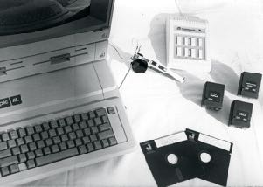

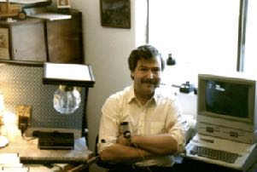

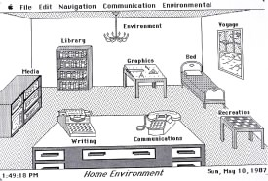

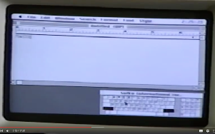
Alternative Structure - Considerations & Discussion Points
Tech & Team
If we spent the entire episode on one discoverer, it would be too flat and boring. By starting with the founder and expanding to include the stories of the #2’s, 3’s, and 4’s of the organization gives the show a multi-dimension depth.
e.g.: The story about Steve Jobs is great, but without the Steve Wozniak component, the story of Apple is incomplete.
And, when I speak with Vint Cerf and call him the “Father of the Internet”, he constantly corrects and reminds me, that he was part of a team. While he may have invented “http://.www.” there were others developing information packets, handshaking, and relays.

Slide 18
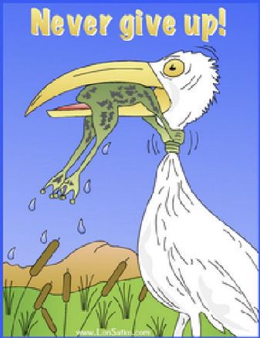
Each Episode Must Contain
Each episode needs to contain:
  Sensationalism
  Compelling
  Shocking
  Tear Jerker
  Motivational
  Confrontational
  Tragedy
  Antagonist / Hero
  Despair & Desperation
  Ingenuity
  Creativity
  The American Entrepreneurial Spirit
  Success
  Perseverance

Slide 19
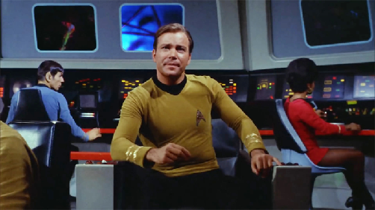
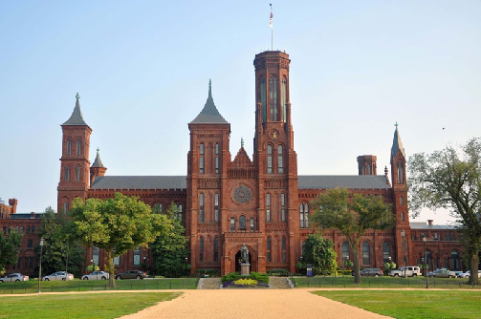
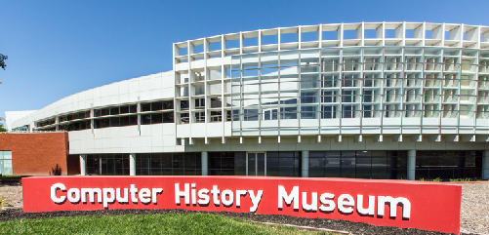
Miscellaneous Notes
I am suggesting that I do the interviews. I have performed hundreds of interviews such as Vint Cerf (Father of the Internet), Biz Stone (Inventor of Twitter), Matt Mullenweg (Inventor of WordPress), and 50 more:
https://www.thesocialmediabible.com/experts-2/
I am not locked into anything. I am flexible and what is best for the series is OK with me.
William Shatner has agreed to be the narrator.
And, as we discussed, I believe each episode should cost out at approximately $250k U.S.
There are lots of other details I can share such as ,I believe we could film this in a very short time as most of the work will be post-production.
We can also film in only three locations, London because of the Da Vinci, San Francisco because of its proximity to Silone Valley where I can most likely get The Computer History Museum to host us, and Washington, D.C. where I could get The Smithsonian Institution to host us. Both museums may host due to my inventions in both.

